Slide 1



Deforestation Detection Using U-Net on Sentinel-2 Imagery

Slide 2

Learning Objectives
Build an automated system to detect deforestation using deep learning and satellite imagery.
Use Sentinel-2 (RGB) cloud-free satellite images to train a U-Net-based segmentation model.
Accurately classify and segment deforested regions at a pixel level from high-resolution remote sensing data.
Focus on clean and cloud-free inputs to improve model accuracy and reduce noise.
Address the need for efficient monitoring of forest degradation, especially in large, remote regions.
Provide actionable insights to support environmental policy, conservation, and early intervention efforts.
Leverage semantic segmentation for precise mapping of deforestation areas for visual and statistical analysis
GOAL
Source :
www.freepik.com/

Slide 3
Tools and Technology used
# Python – Core programming language
# TensorFlow/Keras – U-Net model development
# NumPy & Scikit-learn – Data handling and splitting
# ImageDataGenerator – Data augmentation
# Tifffile – Reading .tif satellite images
# Sentinel-2 (Cloud-Free) – Source of satellite imagery
# Jupyter Notebook – Model training environment

Slide 4
Methodology
1 .Collected cloud-free Sentinel-2 satellite images and corresponding deforestation masks.
2. Preprocessed the data by normalizing image pixel values and removing blank or low-information masks.
3. Extracted 128×128 patches from large satellite images to create a focused training dataset.
4. Applied image augmentation techniques (rotation, flipping, zooming, shifting) to improve generalization.
5. Built a U-Net Convolutional Neural Network model for semantic segmentation of deforested regions.
6. Trained the model using a combination of Dice Loss and Binary Crossentropy to improve accuracy.
7. Validated model performance using Dice Coefficient and Accuracy on unseen image patches.
8 .Visualized predictions to assess the quality and reliability of segmentation results.

Slide 5
Problem Statement:
Deforestation is a pressing global issue that significantly contributes to climate change, ecosystem degradation, and loss of biodiversity. Timely and accurate monitoring of deforested areas is crucial for environmental conservation, but conventional ground-based techniques are often expensive, labor-intensive, and slow.
With the increasing availability of high-resolution satellite imagery like Sentinel-2, there is a growing opportunity to use Artificial Intelligence (AI) and Deep Learning to automate the detection of forest loss. However, developing accurate segmentation models remains challenging due to variability in terrain, image quality, and deforestation patterns.
This project addresses the problem by building a U-Net based deep learning model trained on cloud-free Sentinel-2 imagery and corresponding deforestation masks. The goal is to segment and highlight regions of deforestation with high precision, providing a scalable and efficient tool for environmental monitoring and policy support.

Slide 6
Solution:
This project proposes a deep learning-based approach to automate the detection of deforestation from satellite imagery. A U-Net Convolutional Neural Network (CNN) was trained on preprocessed, cloud-free Sentinel-2 images and corresponding binary deforestation masks. By extracting image patches, applying data augmentation, and using a custom Dice + Binary Crossentropy loss function, the model effectively learns to segment deforested areas. The trained model can then be used to predict deforestation zones on unseen satellite images, enabling scalable, fast, and cost-effective environmental monitoring without relying on manual ground surveys.Where in the predicted mask the white parts are trees and black parts are land/ deforested part.

Slide 7
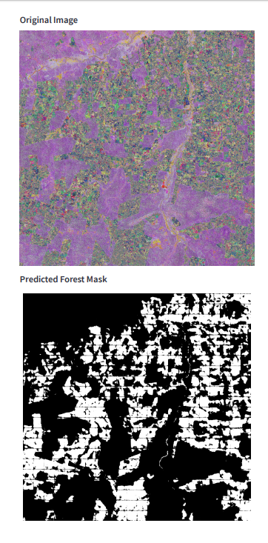
Screenshot of Output:

Slide 8
Conclusion:
This project successfully demonstrates the potential of deep learning, particularly the U-Net architecture, in detecting deforestation from high-resolution Sentinel-2 satellite imagery. By preprocessing the data, filtering relevant image patches, and training a U-Net model with Dice-based loss, we achieved accurate segmentation of deforested regions. The model was able to generalize reasonably well on validation data, even under limited patch size and data constraints. This system can serve as a foundational tool for environmental monitoring and decision-making in forest conservation efforts, and can be further enhanced by incorporating multi-source satellite data or expanding to temporal change detection.

